Slide 1

Beyond mean field solutions to the lattice mixture model
Gabriel H. Brown

Slide 2

Motivation
What is a mixture?
  distinct condensed phases (binary)
  no chemical bonds
2022/05/09
Notes:
General case defined in terms of symmetric constraint tensor B
Unlike matrix case, tensor case has multiple types of eigenvalues in the non-generalized case
Both H and Z kinds are equivalent in the matrix case, but we focus on the Z case from here out
Note that Z case has some ambiguity in the power of norm in normalization condition
Note also that Z-eigenpairs are defined to have real eigenvectors (specializing the case of E-eigenvectors)
(comment on simultaneous discovery)

Slide 3
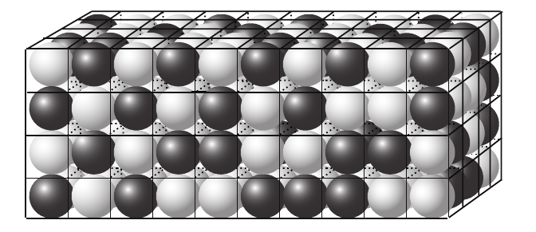
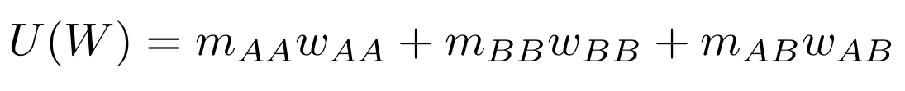
Lattice model of binary mixture
Lattice of N sites, occupied by A or B
three interaction strengths
pairwise, nearest neighbor interactions
Macro variables: volume fraction, temperature, interaction strengths, coordination number
Microstate variables: configuration
Energy of a microstate easily calculated
Dill and Bromberg, Molecular Driving Forces, 2003
2022/05/09
Notes:
General case defined in terms of symmetric constraint tensor B
Unlike matrix case, tensor case has multiple types of eigenvalues in the non-generalized case
Both H and Z kinds are equivalent in the matrix case, but we focus on the Z case from here out
Note that Z case has some ambiguity in the power of norm in normalization condition
Note also that Z-eigenpairs are defined to have real eigenvectors (specializing the case of E-eigenvectors)
(comment on simultaneous discovery)

Slide 4
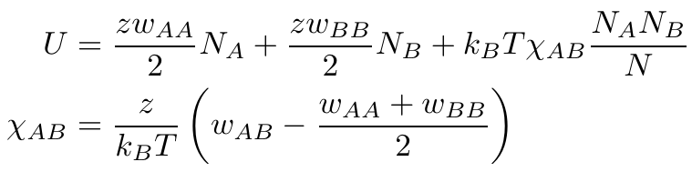

Solving the lattice mixture model
Number of A-A, B-B, A-B interactions algebraically related, one unique
Bragg-Williams approximation assumes lattice is randomly filled
  (equivalent to assuming thermal energy scale > interaction scale)
No dependence: temperature, interaction strengths
Especially poor description for low temperature
Simple, but foundational system
2022/05/09
Notes:
General case defined in terms of symmetric constraint tensor B
Unlike matrix case, tensor case has multiple types of eigenvalues in the non-generalized case
Both H and Z kinds are equivalent in the matrix case, but we focus on the Z case from here out
Note that Z case has some ambiguity in the power of norm in normalization condition
Note also that Z-eigenpairs are defined to have real eigenvectors (specializing the case of E-eigenvectors)
(comment on simultaneous discovery)

Slide 5
Overview
Goal:
  analytical or semi-empirical form normalized internal energy
Compute:
  construct efficient method to “solve” system, evaluate internal energies
  use method to build data set
Fit/model:
  examine symmetries of function
  propose conformant model forms
  fit and evaluate models
2022/05/09
Notes:
General case defined in terms of symmetric constraint tensor B
Unlike matrix case, tensor case has multiple types of eigenvalues in the non-generalized case
Both H and Z kinds are equivalent in the matrix case, but we focus on the Z case from here out
Note that Z case has some ambiguity in the power of norm in normalization condition
Note also that Z-eigenpairs are defined to have real eigenvectors (specializing the case of E-eigenvectors)
(comment on simultaneous discovery)

Slide 6
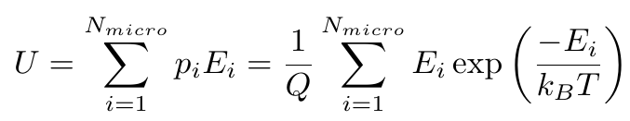
Compute: naive scheme issues
Internal energy of macrostate of the lattice mixture dependent on all microstates
Number of microstates factorially dependent on lattice size
Exponentially large intermediates
2022/05/09
Notes:
General case defined in terms of symmetric constraint tensor B
Unlike matrix case, tensor case has multiple types of eigenvalues in the non-generalized case
Both H and Z kinds are equivalent in the matrix case, but we focus on the Z case from here out
Note that Z case has some ambiguity in the power of norm in normalization condition
Note also that Z-eigenpairs are defined to have real eigenvectors (specializing the case of E-eigenvectors)
(comment on simultaneous discovery)

Slide 7
Compute: Metropolis
Metropolis algorithm
  “Markov chain Monte Carlo method to sample from unknown/difficult/high dimensional probability distribution”
  generates random walk along probability distribution, sampling relatively high probability areas more frequently
  expectation values computable from naive average of observable at each Monte Carlo step
First proposed by Metropolis et. al in context of continuous space molecular dynamics
2022/05/09
Notes:
General case defined in terms of symmetric constraint tensor B
Unlike matrix case, tensor case has multiple types of eigenvalues in the non-generalized case
Both H and Z kinds are equivalent in the matrix case, but we focus on the Z case from here out
Note that Z case has some ambiguity in the power of norm in normalization condition
Note also that Z-eigenpairs are defined to have real eigenvectors (specializing the case of E-eigenvectors)
(comment on simultaneous discovery)

Slide 8
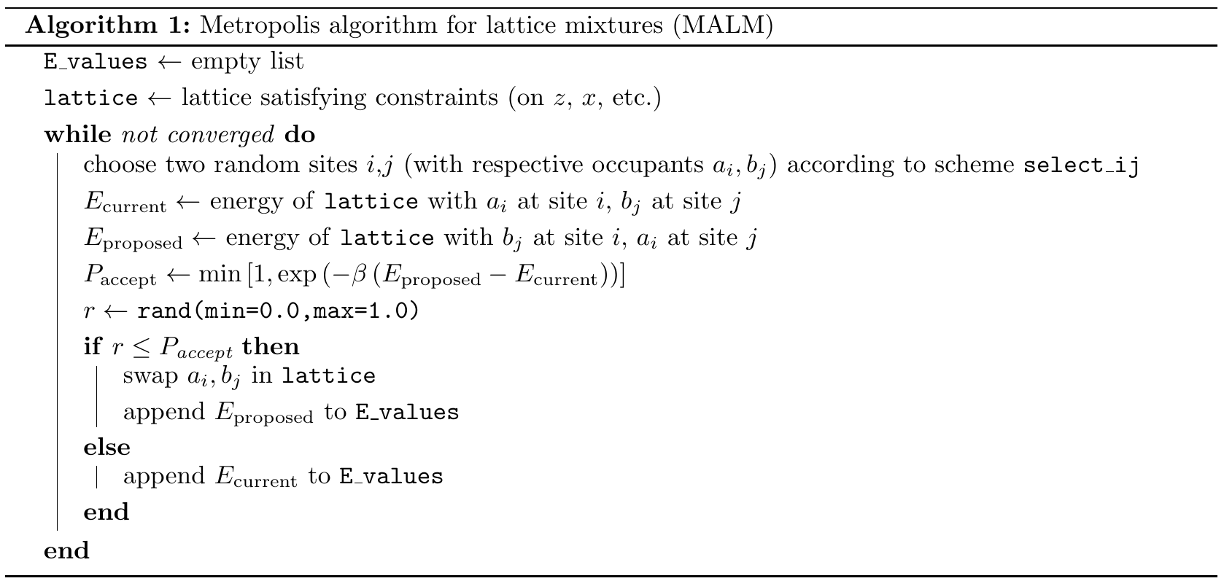
Compute: MALM
2022/05/09
Notes:
General case defined in terms of symmetric constraint tensor B
Unlike matrix case, tensor case has multiple types of eigenvalues in the non-generalized case
Both H and Z kinds are equivalent in the matrix case, but we focus on the Z case from here out
Note that Z case has some ambiguity in the power of norm in normalization condition
Note also that Z-eigenpairs are defined to have real eigenvectors (specializing the case of E-eigenvectors)
(comment on simultaneous discovery)

Slide 9


Compute: verify (melting)
low coldness (high temperature) limit
  all microstates occupied equally
  equilibrium is random lattice
  in terms of MALM, all proposed moves accepted
initial conditions: solid band of B sites in middle
2022/05/09
Notes:
General case defined in terms of symmetric constraint tensor B
Unlike matrix case, tensor case has multiple types of eigenvalues in the non-generalized case
Both H and Z kinds are equivalent in the matrix case, but we focus on the Z case from here out
Note that Z case has some ambiguity in the power of norm in normalization condition
Note also that Z-eigenpairs are defined to have real eigenvectors (specializing the case of E-eigenvectors)
(comment on simultaneous discovery)

Slide 10


Compute: verify (freezing)
high coldness (low temperature) limit
  low energy microstates preferred
  equilibrium minimizes number of least favorable interactions
  in terms of MALM, only energetically favorable proposals accepted
initial conditions: random lattice
same parameters as melting, except:
2022/05/09
Notes:
General case defined in terms of symmetric constraint tensor B
Unlike matrix case, tensor case has multiple types of eigenvalues in the non-generalized case
Both H and Z kinds are equivalent in the matrix case, but we focus on the Z case from here out
Note that Z case has some ambiguity in the power of norm in normalization condition
Note also that Z-eigenpairs are defined to have real eigenvectors (specializing the case of E-eigenvectors)
(comment on simultaneous discovery)

Slide 11
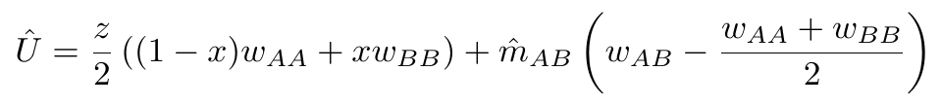

Compute: one dimensional trends
Work in terms of number of A-B interactions per site, rather than energy
  saves trouble of reinventing terms when developing models
Non-varied parameters:
Bragg-Williams approximation predicts 1.0 uniformly
  (unless volume fraction or coordination number varied)
2022/05/09
Notes:
General case defined in terms of symmetric constraint tensor B
Unlike matrix case, tensor case has multiple types of eigenvalues in the non-generalized case
Both H and Z kinds are equivalent in the matrix case, but we focus on the Z case from here out
Note that Z case has some ambiguity in the power of norm in normalization condition
Note also that Z-eigenpairs are defined to have real eigenvectors (specializing the case of E-eigenvectors)
(comment on simultaneous discovery)

Slide 12
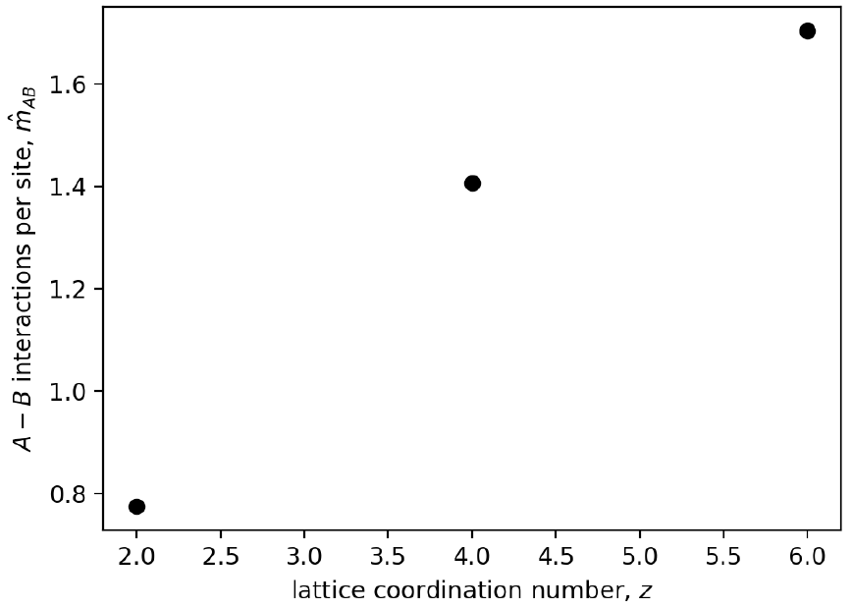
Compute: 1-D trends, coordination number
expected linear relationship
2022/05/09
Notes:
General case defined in terms of symmetric constraint tensor B
Unlike matrix case, tensor case has multiple types of eigenvalues in the non-generalized case
Both H and Z kinds are equivalent in the matrix case, but we focus on the Z case from here out
Note that Z case has some ambiguity in the power of norm in normalization condition
Note also that Z-eigenpairs are defined to have real eigenvectors (specializing the case of E-eigenvectors)
(comment on simultaneous discovery)

Slide 13
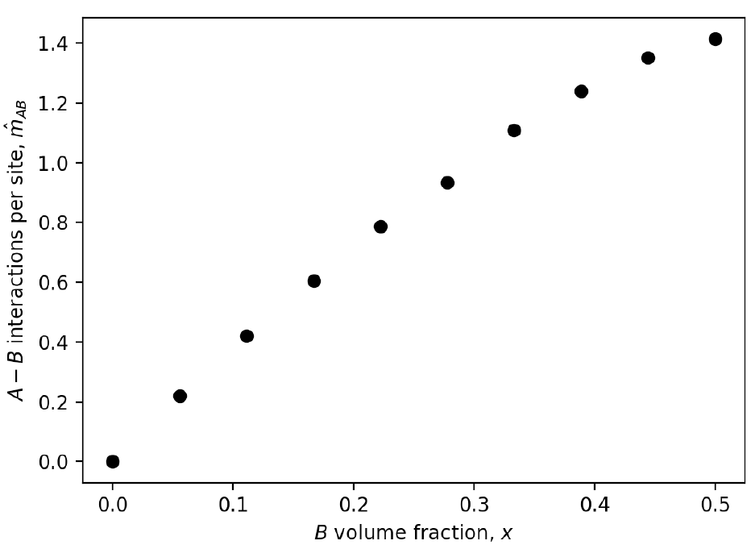
Compute: 1-D trends, volume fraction
appears quadratic, like Bragg-Williams predicts
achieves analytical value value for full A lattice
only up to half B due to symmetry*
2022/05/09
Notes:
General case defined in terms of symmetric constraint tensor B
Unlike matrix case, tensor case has multiple types of eigenvalues in the non-generalized case
Both H and Z kinds are equivalent in the matrix case, but we focus on the Z case from here out
Note that Z case has some ambiguity in the power of norm in normalization condition
Note also that Z-eigenpairs are defined to have real eigenvectors (specializing the case of E-eigenvectors)
(comment on simultaneous discovery)

Slide 14
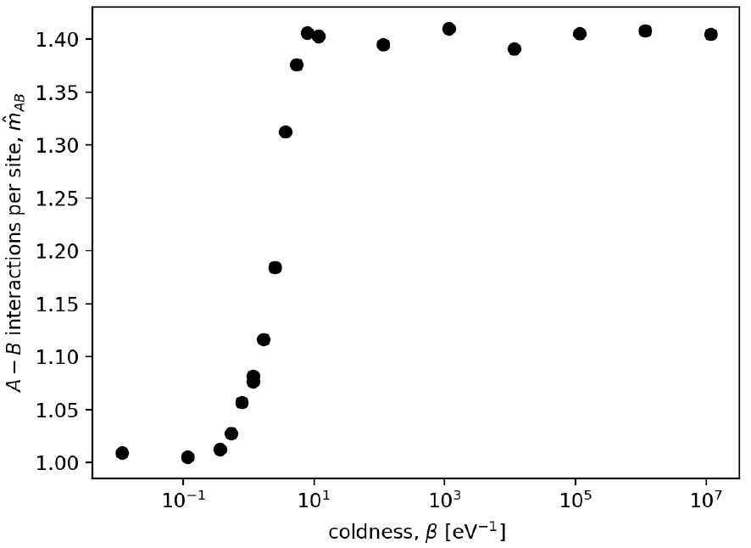
Compute: 1-D trends, coldness
agrees with Bragg-Williams in low coldness (high temperature) limit
clear disagreement for cold systems
2022/05/09
Notes:
General case defined in terms of symmetric constraint tensor B
Unlike matrix case, tensor case has multiple types of eigenvalues in the non-generalized case
Both H and Z kinds are equivalent in the matrix case, but we focus on the Z case from here out
Note that Z case has some ambiguity in the power of norm in normalization condition
Note also that Z-eigenpairs are defined to have real eigenvectors (specializing the case of E-eigenvectors)
(comment on simultaneous discovery)

Slide 15
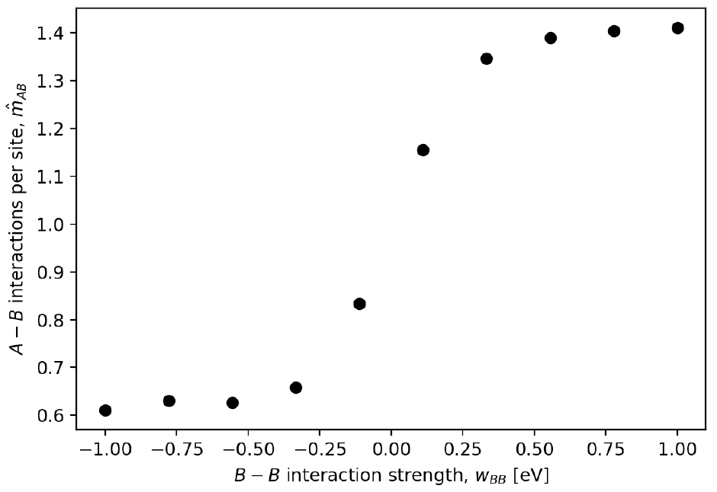
Compute: 1-D trends, B-B interaction
no dependence on A-A interaction strength
transition with B-B interaction strength
symmetry implies A-A has same behavior, possibly different range)
2022/05/09
Notes:
General case defined in terms of symmetric constraint tensor B
Unlike matrix case, tensor case has multiple types of eigenvalues in the non-generalized case
Both H and Z kinds are equivalent in the matrix case, but we focus on the Z case from here out
Note that Z case has some ambiguity in the power of norm in normalization condition
Note also that Z-eigenpairs are defined to have real eigenvectors (specializing the case of E-eigenvectors)
(comment on simultaneous discovery)

Slide 16
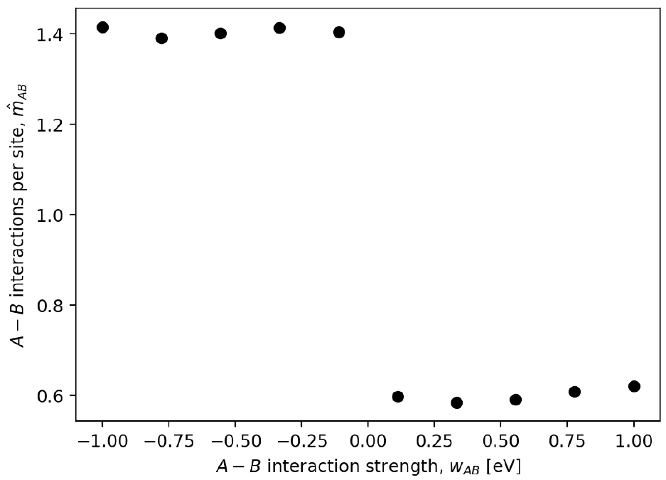
Compute: 1-D trends, A-B interaction
transition structure present again
2022/05/09
Notes:
General case defined in terms of symmetric constraint tensor B
Unlike matrix case, tensor case has multiple types of eigenvalues in the non-generalized case
Both H and Z kinds are equivalent in the matrix case, but we focus on the Z case from here out
Note that Z case has some ambiguity in the power of norm in normalization condition
Note also that Z-eigenpairs are defined to have real eigenvectors (specializing the case of E-eigenvectors)
(comment on simultaneous discovery)

Slide 17
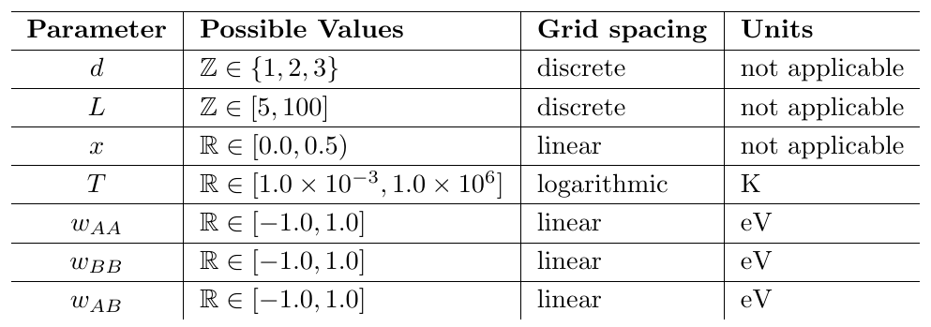
Compute: data set
Seven dimensional parameter space (six plus lattice side length)
Sampled and solved:
  128 extreme points (hypercube vertices)
  1000 random internal points
2022/05/09
Notes:
General case defined in terms of symmetric constraint tensor B
Unlike matrix case, tensor case has multiple types of eigenvalues in the non-generalized case
Both H and Z kinds are equivalent in the matrix case, but we focus on the Z case from here out
Note that Z case has some ambiguity in the power of norm in normalization condition
Note also that Z-eigenpairs are defined to have real eigenvectors (specializing the case of E-eigenvectors)
(comment on simultaneous discovery)

Slide 18

Model: process overview
Develop analytical or semi-empirical model for internal energy
So called “model function” for number of A-B interactions per site
Semi-empirical model functions have model parameters, which are fit by nonlinear least squares
2022/05/09
Notes:
General case defined in terms of symmetric constraint tensor B
Unlike matrix case, tensor case has multiple types of eigenvalues in the non-generalized case
Both H and Z kinds are equivalent in the matrix case, but we focus on the Z case from here out
Note that Z case has some ambiguity in the power of norm in normalization condition
Note also that Z-eigenpairs are defined to have real eigenvectors (specializing the case of E-eigenvectors)
(comment on simultaneous discovery)

Slide 19
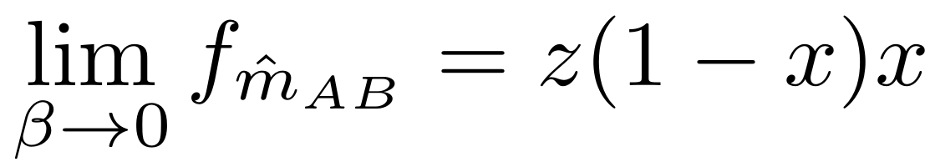
Model: model function constraints
Trivial: proper units (unitless), strictly positive
Symmetry under relabeling
Recover Bragg-Williams in low coldness (high temperature) limit
Linear dependence on coordination number
  modeling “per site” quantity
2022/05/09
Notes:
General case defined in terms of symmetric constraint tensor B
Unlike matrix case, tensor case has multiple types of eigenvalues in the non-generalized case
Both H and Z kinds are equivalent in the matrix case, but we focus on the Z case from here out
Note that Z case has some ambiguity in the power of norm in normalization condition
Note also that Z-eigenpairs are defined to have real eigenvectors (specializing the case of E-eigenvectors)
(comment on simultaneous discovery)

Slide 20
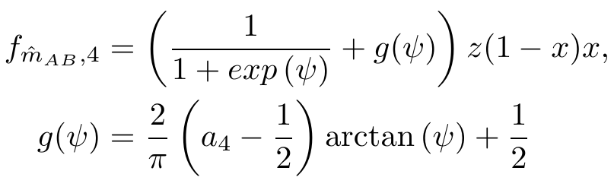
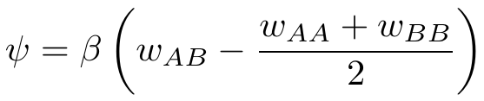
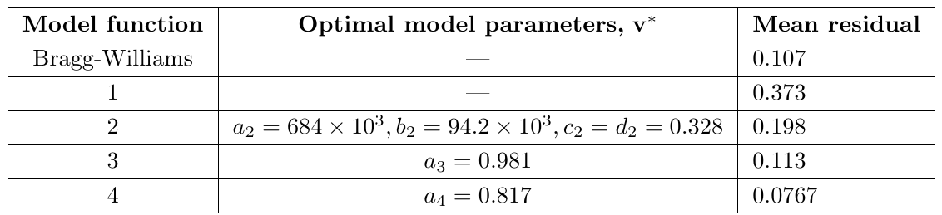
Model: final results
Constructed multiple functions, many obeyed constraints but had other issues
Able to moderately (30%) outperform Bragg-Williams
2022/05/09
Notes:
General case defined in terms of symmetric constraint tensor B
Unlike matrix case, tensor case has multiple types of eigenvalues in the non-generalized case
Both H and Z kinds are equivalent in the matrix case, but we focus on the Z case from here out
Note that Z case has some ambiguity in the power of norm in normalization condition
Note also that Z-eigenpairs are defined to have real eigenvectors (specializing the case of E-eigenvectors)
(comment on simultaneous discovery)

Slide 21
Future work
More structured approach to finding underlying model function
Non-dimensionalize/compress model into fewer parameters
2022/05/09
Notes:
General case defined in terms of symmetric constraint tensor B
Unlike matrix case, tensor case has multiple types of eigenvalues in the non-generalized case
Both H and Z kinds are equivalent in the matrix case, but we focus on the Z case from here out
Note that Z case has some ambiguity in the power of norm in normalization condition
Note also that Z-eigenpairs are defined to have real eigenvectors (specializing the case of E-eigenvectors)
(comment on simultaneous discovery)

Slide 22
Future work
???
2022/05/09
Notes:
largest magnitude: NP hard problem, analogous algorithm (SHOPM) only convergent under certain conditions on tensor
shifted inverse iteration: no eigenvalue shift property,
tensor inverse relatively new concept not clear if its definition is helpful in this problem
subspace methods: eigenvectors not orthogonal in general, more than n eigenpairs

